Slide 1


The Python SQL Toolkit
SQL ALCHEMY
Advanced Programming Midterm Presentation
Presented By: Vanshika Gupta

Slide 2


01 | What is SQLAlchemy?
02 | Why do we use SQLAlchemy?
03 | Why It’s Great for Data Scientists
04 | Basic Building Blocks of SQLAlchemy
05 | My Project: Spotify Dataset Analysis
06 | Business Questions I Answered
07 | What I Learned from SQLAlchemy
08 | Conclusion and Tutorial
Agenda

Slide 3

What is SQLAlchemy?
01
SQLAlchemy is a Python library that helps you work with databases easily.
02
You can think of it like this:
SQL is the language of databases.
Python is the language of data science.
SQLAlchemy connects the two.
03
SQLAlchemy has two main layers:
  Core – This is the lower-level layer where you write SQL expressions using Python syntax.
  ORM (Object Relational Mapper) – This is the high-level layer that lets you work with Python objects instead of SQL tables.

Slide 4




Why do we use SQLAlchemy?
It connects Python to databases.
It saves time.
Instead of writing long SQL code, you can just use short Python commands.
You can connect to almost any database — like SQLite, MySQL, or PostgreSQL.
It’s safe and reliable.
It works with pandas.
SQLAlchemy prevents common database mistakes like inserting duplicates or deleting wrong data accidentally.
You can easily move data between pandas and SQL

Slide 5

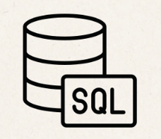


Why It’s Great for Data Scientists
SQLAlchemy helps because:
  You can pull data directly from databases into Python.
  You can filter, group, and clean it using SQL commands from inside your notebook.
  You can save results back into the database — no need for Excel or CSVs.
It’s like having Excel, SQL, and Python all in one place.

Slide 6
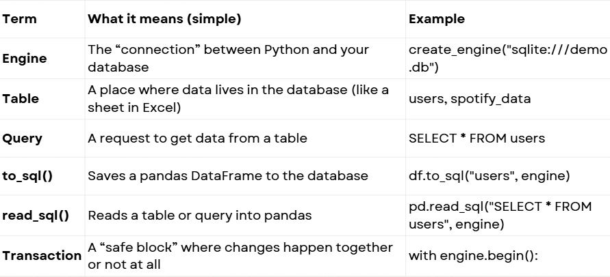
Basic Building Blocks of SQLAlchemy

Slide 7
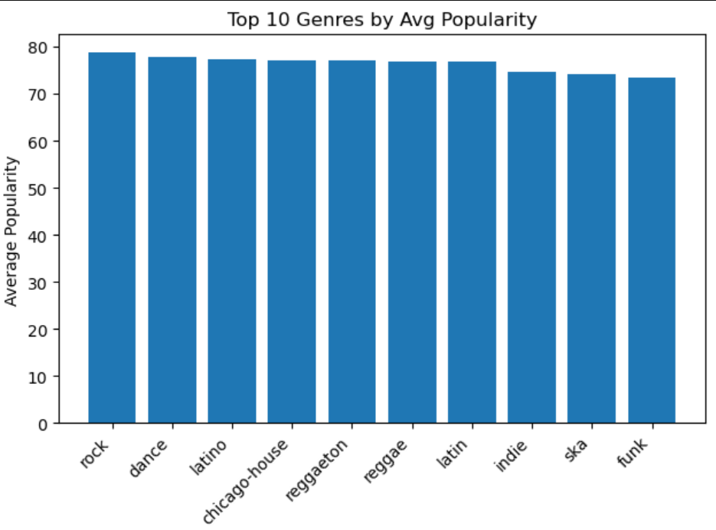
My Project: Spotify Dataset Analysis
Used a real Spotify dataset (~600,000 tracks)
Imported it into a database using SQLAlchemy
Explored music patterns with SQL queries in Python
Answered business questions using data

Slide 8
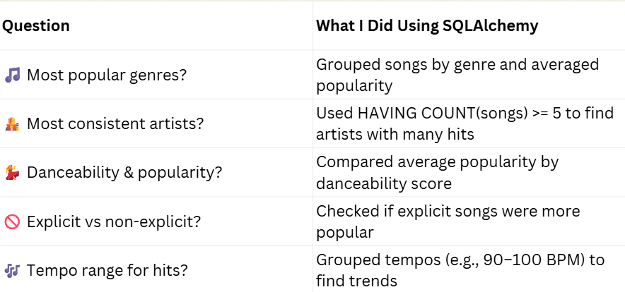
Business Questions I Answered

Slide 9

What I Learned from SQLAlchemy
1.
2.
3.
4.
5.
SQLAlchemy made data handling faster and safer
Easy to connect Python, pandas, and SQL together
Helped me analyze, filter, and visualize data directly
Similar approach can be used for real company databases
Built a complete pipeline: load → query → analyze → visualize

Slide 10
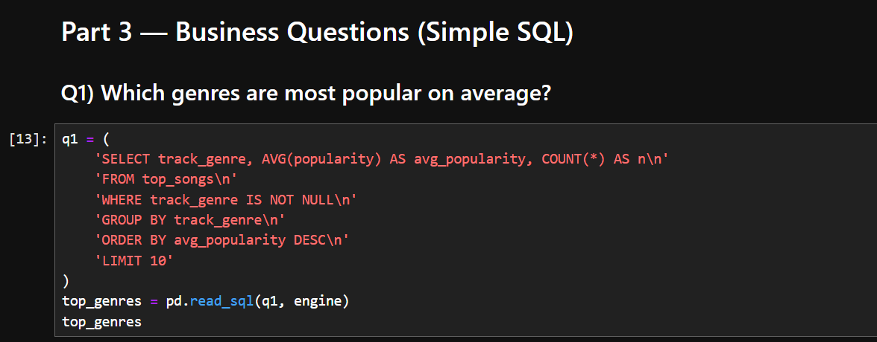
Conclusion and Tutorial
  To conclude, SQLAlchemy really simplified how I worked with large datasets.
  It connected Python and SQL perfectly, so I could query and analyze Spotify data easily inside my notebook.
  It saved time, reduced complexity, and made my analysis more structured and scalable.
  Overall, it’s a great tool for anyone working in data science, especially when dealing with databases in real projects.

Slide 11
Thank you!
By Vanshika Gupta

